Slide 1
Connect Four

Slide 2
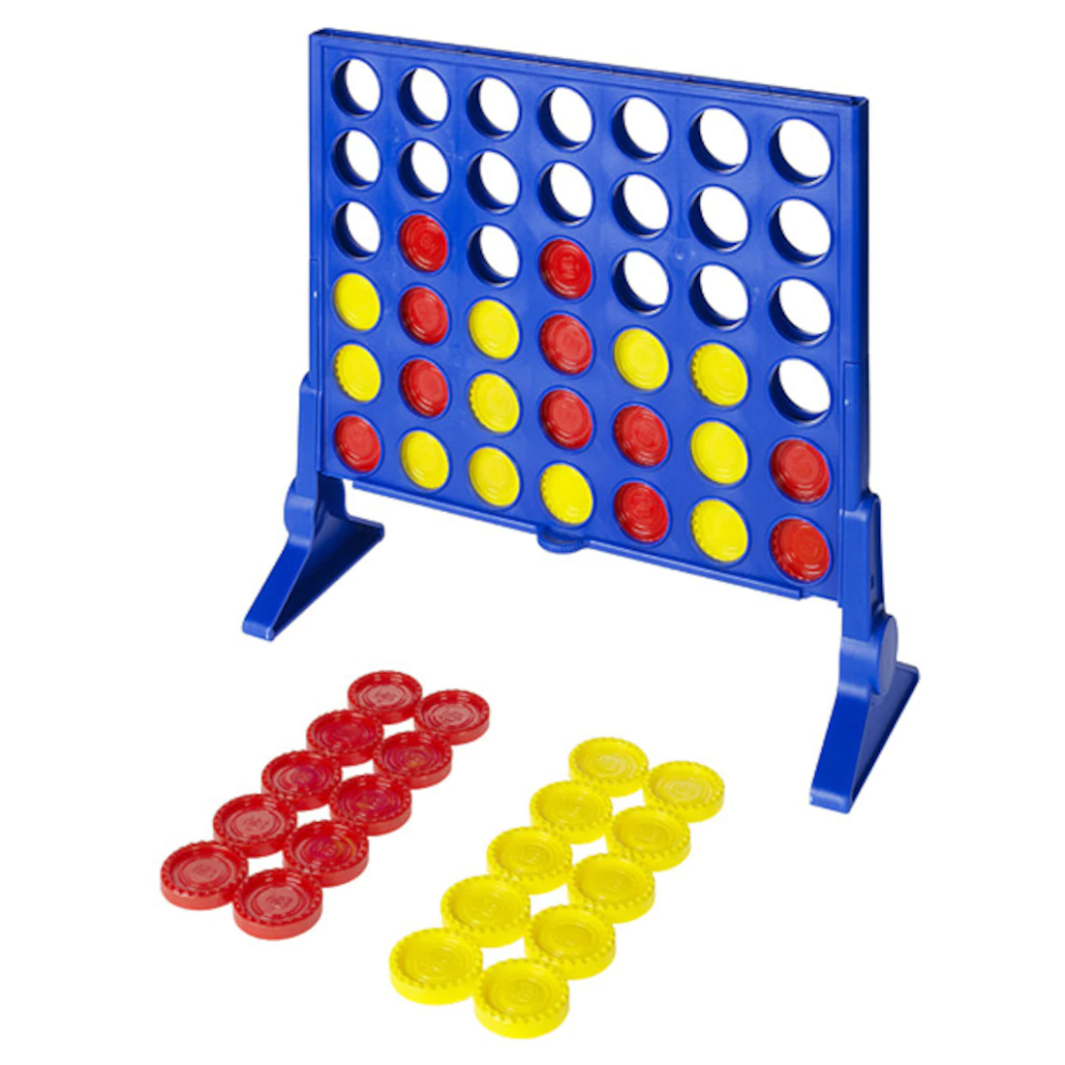
Connect Four
What Connect Four is and how it is played
How we plan on implementing our version of Connect 4 using Python.
Some of the larger components in the game and why they are important.
Some difficulties we expect to encounter and how we are planning to tackle them.

Slide 3
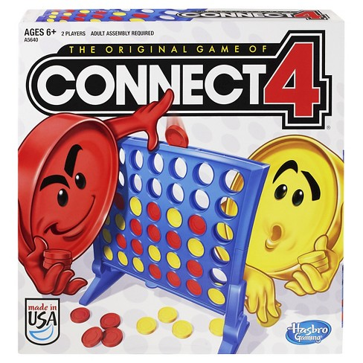
What is Connect Four
Connect 4 is a fairly simple game in which 2 players alternate dropping their own coloured discs into a 7x6 board – from the top.
Each player is trying to claim victory by connecting 4 of their pieces, either vertically, horizontally, or diagonally, before the other player can do the same.

Slide 4
4 Core classess

Slide 5
Player Class
Implentation
Attributes:
(1) Colour(String): Colour of pieces that player uses.
(2) Board(Board class): Current board status.
Method:
(1) move_left() -> None: Player moves the piece toward the left.
(2) move_right() -> None: Player moves the piece toward the right.
(3) drop() -> None: Player drops the piece.
(4) check_for_win(Board) -> Boolean: Check whether the player wins.
The implementation of the above methods will base on how board class and main class will be implemented.

Slide 6
Event Capture
In order to capture the events made by the players, there will be a while loop in the main class.
running = Ture
while running:
for event in pygame.event.get():
if event == A key or event == home key:
player.move_left()
if event == D key or event == end key:
player.move_right()
if event == space key or event == enter key:
player.drop()
if player.check_for_win(Board):
running = False.
Player in the loop is a variable representing the current player.

Slide 7
Board Class
Attributes:
(1) 2 Player Characters (each a final Strings) represents the player piece names. Called P1 and P2.
(2) Empty Character (final String) represents an empty space. Called EMPTY.
(3) Dimension for length and width (each an int). Called dim_length, dim_width.
(4) Board Grid (nested list of Strings with depth 2) represents the actual board containing represented pieces.

Slide 8
Board Class
Methods:
(1) move_left() -> None: Player moves drop spot one column to the left.
(2) move_right() -> None: Player moves drop spot one column to the right.
(3) whos_turn() -> Player: Who is making the move?
(4) drop() -> None: Player drops the piece. The player’s character is placed in the lowest empty spot in that column.
(5) check_for_win() -> Boolean: Check whether the player wins. Go through the board and see if there is a row, column or diagonal of four consecutive pieces of the same player.
(6) valid_move() -> Boolean: Check if the player’s requested drop position is in accordance to the game rules and fits in the nested list grid.

Slide 9
Board and Player classes will be the hardest implementations
Here’s why...

Slide 10
Board Consideration or Edge Cases
The Board class will have functions that address the complications of accessing and manipulating a grid.
Ex.
Checking for a ‘Connect-4’ in a corner, an edge, or the center of a board
All moves are within the dimensions of the game board
What if a player tries to drop a piece in a filled up column?
What if a player tries to break the game with invalid inputs or commands?
How can the privacy of the methods be maintained?

Slide 11
Valid_move Pseudo Code
Parameter will be the drop position(column number) of the current player playing.
If 0 <= position(int) <= dimension of columns - 1:
If there is an empty space in the column: (harder to access)
return True
Else:
return False

Slide 12
Check_for_win Pseudo Code
For every row of the grid:
For every column of the grid:
For every possible row direction according to spot:
For every possible column direction according to spot:
Follow the direction and check for four consecutive P1 or P2
If there is a ‘Connect-4’ and it belong to whos_turn: Return True
Anything else will return false.

Slide 13
Game Elements:
Disks:
Player 1: red
Player 2: blue
Board:
- The disk signifying each players position on the board.
- A 7x6 board that holds the disks and signifies when there are 4 in a row.
- Navigation buttons to take the user between different views in the game

Slide 14
Game Mechanics
How to Play
4-to-Connect is a computer program based on the classic game Connect 4.
Two Players take turns dropping disks into columns with slots.
First player to make a move plays with red disks and the second with yellow.
Once player 1 or 2 claims victory by having 4 disks connected, no more moves can be made.
Rules
Disks are dropped into the last empty slot of the column.
Players cannot drop a disk in a column that is filled.
Once all 42 slots are filled, no more moves can be made. The game is finished and no player wins.
Notes:
Time: 24 seconds

Slide 15

Input and Output Devices
Computer Mouse
User can click above a column to make a move
User can press several different buttons that show them different views
Computer Monitor
Screen
Start View
Help View
Play View
End View
Notes:
Time: 20 seconds

Slide 16
GUI Components
Pygame display surface represents the only screen of the game.
Display Surface
Display Surface Major Update 1 – Start View
Start, Help, Exit and Close Window Button
Text Fields
Few updates
Display Surface Major Update 2 – Help View
Start, Exit and Close Window Button
Text Fields
Few updates
Display Surface Major Update 3 – Play View
Help, Exit and Close Window Button
Board
Text Fields
Multiple updates
Display Surface Major Update 4 – End View
Play Again, Help and Close Window Button
Text Fields
Few updates
Notes:
Time: 29 seconds

Slide 17
Start View
4 to Connect
4-to-Connect
Start
Help
Creators
Calvin Vadivelu
Gen Tomita
Hafsah Moalim
Ilija Zivkovic
Exit
Notes:
Time: 7 seconds

Slide 18
Help View
4 to Connect
4-to-Connect is a computer program based on the classic game Connect 4. To begin playing, press the start button.
How to Play
This game requires two players, a 7x6 board and disks that are either red or yellow. Players take turns dropping disks into columns until a player wins or no more moves are possible. To win, a player must have made 4 disks of their colour be in a row, column or diagonal. The game is a tie when all 42 slots are filled with disks.
Controls
The first player to make a move will be player 1 and have a red disk. When it is your turn to make a move, click the a unfilled column that you would like to drop a disk in. The disk representing your colour will appear in the last empty slot of the column and the other player can then make a move.
Start
Exit
Notes:
Time: 5 seconds

Slide 19
Play View
4 to Connect
Help
Exit
Player ___ , it is your turn!
Notes:
Time: 3 seconds

Slide 20
End View
4 to Connect
Player __ won!
Thanks for playing!
Play Again
Help
Creators
Calvin Vadivelu
Gen Tomita
Hafsah Moalim
Ilija Zivkovic
Fair dealing for the purpose of research, private study, education, parody or satire does not infringe copyright under Canada’s Copyright Act.
Notes:
Time: 3 seconds

Slide 21
Importance of GUI
The graphical user interface will allow the user to interact with 4-to-Connect
Will have primary use of pygame
Objects
pygame.Surface
Pygame.Rect
pygame.Color
Modules
pygame.mouse
pygame.draw
pygame.display
pygame.event
Notes:
Time: 7 seconds

Slide 22
Conclusion
The main workflow
Show start view from GUI class
Initialize all instance
Running main loop
Throw the result view once board class detect winner
Ask for new game ( If so, redo the inilialization)

Slide 23
Conclusion
What we have talked??
4 core classes
UI design
Our goal
Simple implementation
User friendly
Sustainability

